Slide 1

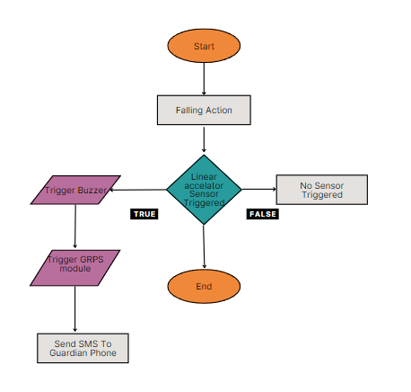
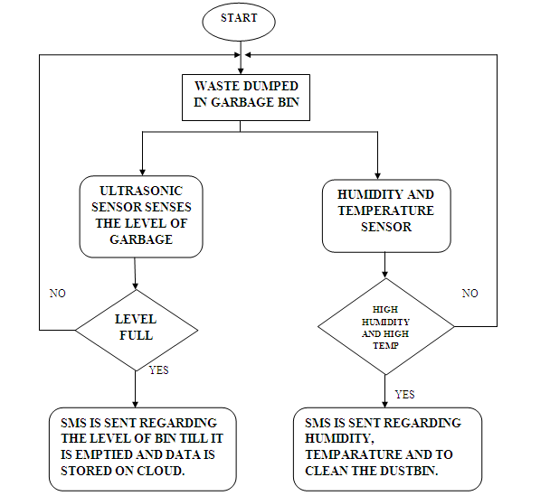
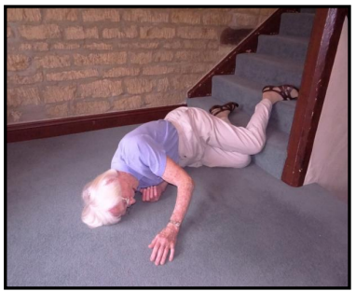
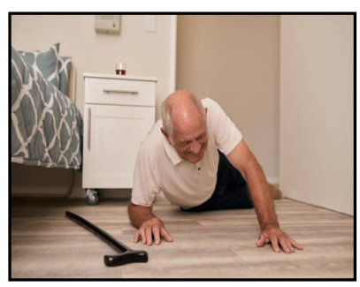
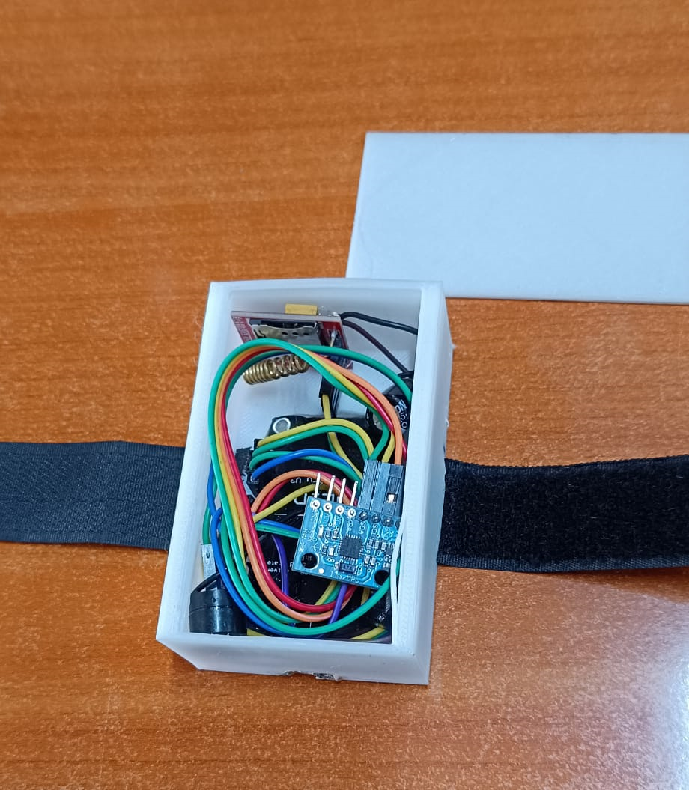
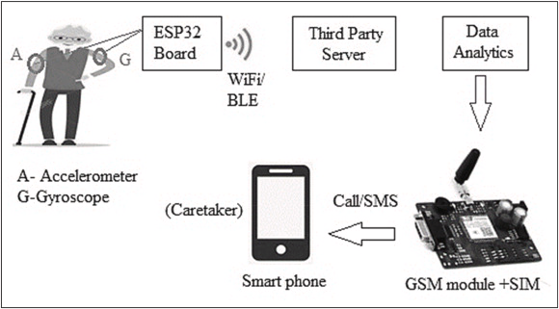
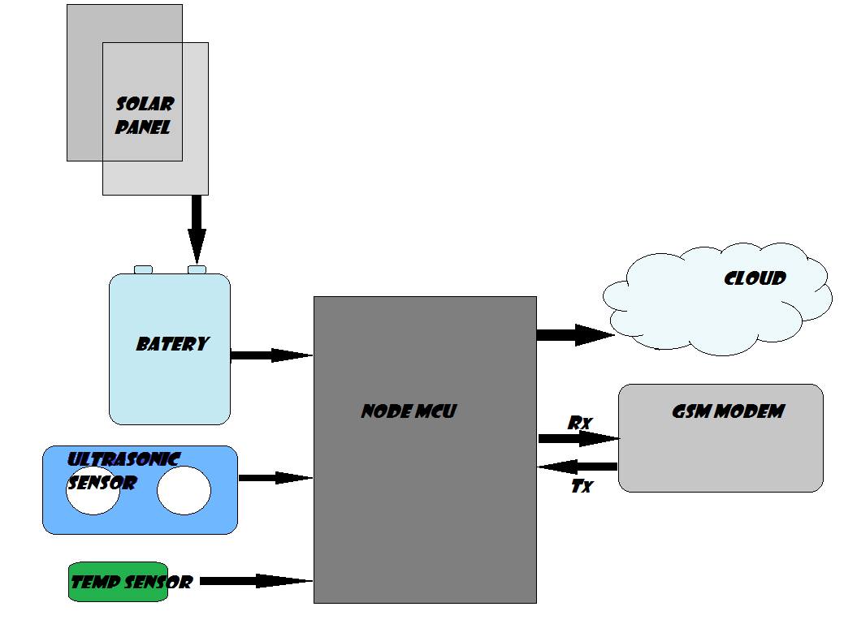
ELDER CARE MANAGEMENT SYSTEM
DEPARTMENT OF COMPUTER SCIENCE & ENGINEERING|6BTCS-C|CHRIST UNIVERSITY
Motivation/ Introduction
Fig 3. work flow of Fall Detection
1. Start: The process begins here.
2. Trigger Buzzer: This step initiates the buzzer, likely to indicate the system is starting or ready. It might also serve as a placeholder for other initialization steps not shown in this flowchart.
3. Linear Accelerator Sensor Triggered: The flowchart checks if the linear acceleration sensor (likely the ADXL345) has been triggered, which could indicate a fall.
4. TRUE: If the sensor is triggered, proceed to the next step.
5. FALSE: If the sensor is not triggered, the process ends here, likely because the event wasn't strong enough to be considered a fall.
6. Trigger GRPS Module: This step activates the GRPS (General Packet Radio Service) module, which is part of the SIM800L GSM module. GRPS enables data transfer over a cellular network, which is likely necessary to send an SMS message in the next step.
7. Send SMS To Guardian Phone: An SMS message is sent to the guardian's phone number, presumably to notify them about a possible fall.
8. End: The process terminates here.
An Elder Care Management System utilizing IoT for fall detection is a comprehensive solution designed to enhance the safety and well-being of elderly individuals. Leveraging Internet of Things (IoT) technology, this system employs sensors and data analytics to detect and respond to falls promptly. By continuously monitoring the movements and activities of the elderly person, it can identify potential falls in real-time, triggering immediate alerts to caregivers or emergency services. This proactive approach not only reduces response time but also provides peace of mind to both the elderly and their families. Additionally the system can offer valuable insights to the indivisuals.
SCOPE of the Project
The scope of an IoT-based Elder Care Management System focusing on fall detection encompasses various aspects, including:
Sensor Deployment: Determining the type and placement of sensors such as accelerometers, gyroscopes, or pressure sensors in the living environment to accurately detect falls while minimizing false alarms.
Data Acquisition and Processing: Collecting and processing sensor data in real-time to analyze movement patterns and detect anomalies indicative of a fall event.
Fall Detection Algorithms: Developing and implementing robust algorithms capable of accurately identifying falls while distinguishing them from other activities like sitting down or sudden movements.
Alert Mechanisms: Establishing efficient alert mechanisms to promptly notify caregivers, family members, or emergency services in the event of a fall, utilizing methods such as mobile notifications, SMS,
Fig 1. Present scenario of elders
Integration with Existing Systems: Integrating the fall detection system with existing home automation or healthcare management platforms to ensure seamless monitoring and response.
User Interface: Designing user-friendly interfaces for both caregivers and elderly individuals, allowing them to monitor activity levels, receive alerts, and access historical data for analysis.
Results:
Expected outcomes:
Increased Safety and Security: If a fall does occur, the system can promptly send an SMS alert to designated guardians, allowing them to respond quickly and potentially minimize the consequences of the fall.
2. Improved Peace of Mind: Both the elders and their caregivers may experience greater peace of mind knowing that the system is in place to provide assistance in case of a fall. This can reduce anxiety and worry, especially for caregivers who may not be able to be present with the elder all the time.
3. Potential for Early Intervention: Timely notification of a fall allows for faster medical attention, which can significantly improve the chances of a full recovery and reduce the risk of complications, especially for falls with potential injuries.
Fig 4. Implementation
The figure above shows the implementation, with the snesors and other hardware components mounted on the dustbin
Fig 2.Architecture for elder care management:
Collects sensor data (e.g., accelerometer, gyroscope).
Sends data to server (Wi-Fi/Bluetooth).
Server analyzes data.
Triggers actions (e.g., alerts, SMS) based on analysis (optional: GSM module).
Methodology
Conclusion
The diagram depicts an automated Fall detection system. The ESP8266 board acts as the data collector, transmitting sensor data (e.g., accelerometer) to a server for analysis. This analysis can then trigger actions, such as sending alerts or SMS messages, utilizing the optional GSM module.
Contact Details:
sanjay.s@btech.christuniversity.in
kushal.gowda@btech.christuniversity.in
g.rajesh@btech.christuniversity.in
nelluru.uma@btech.christuniversity.in

